Slide 1


One day Android Master with Firebase
-Fauzi Sholichin-

Slide 2







Android Development Tools 2019

Slide 3





Today :

Slide 4
Firebase Setup

Slide 5
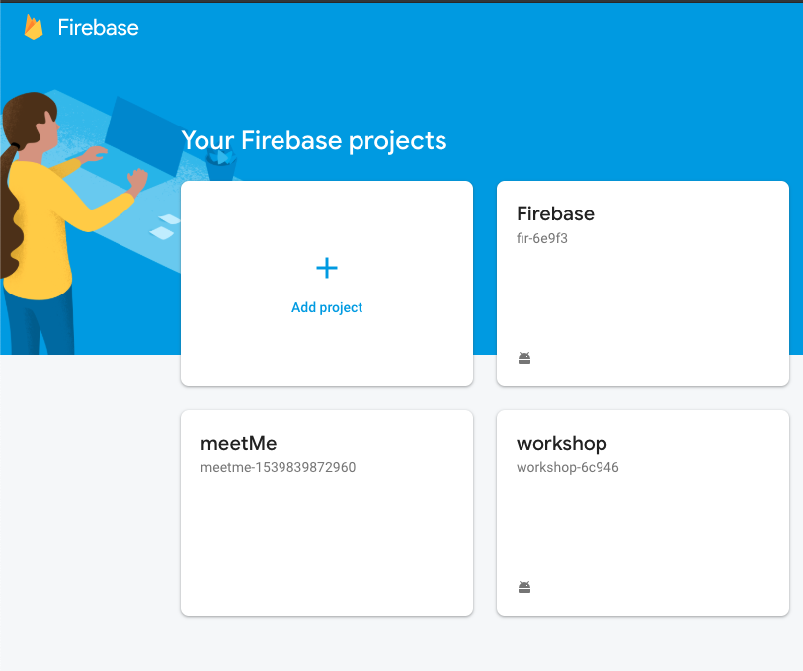
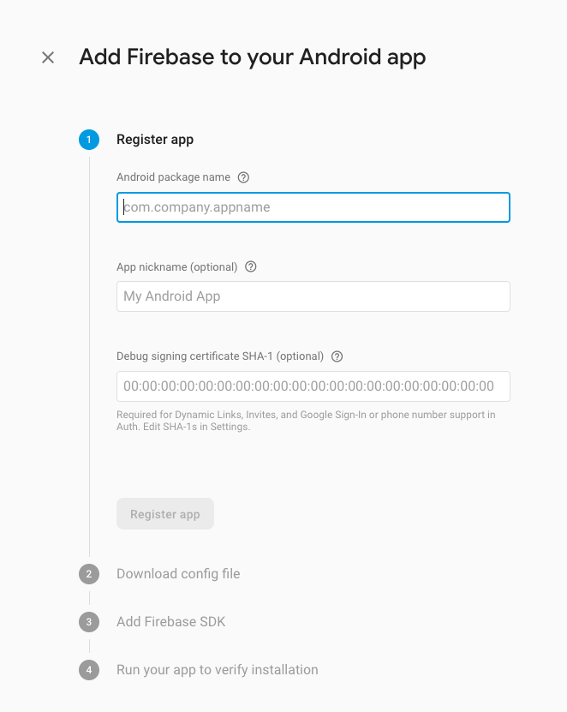
New Project

Slide 6
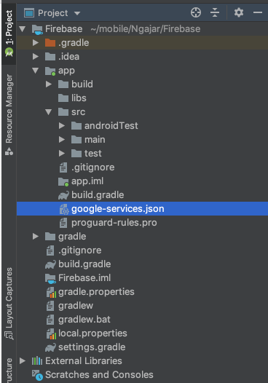
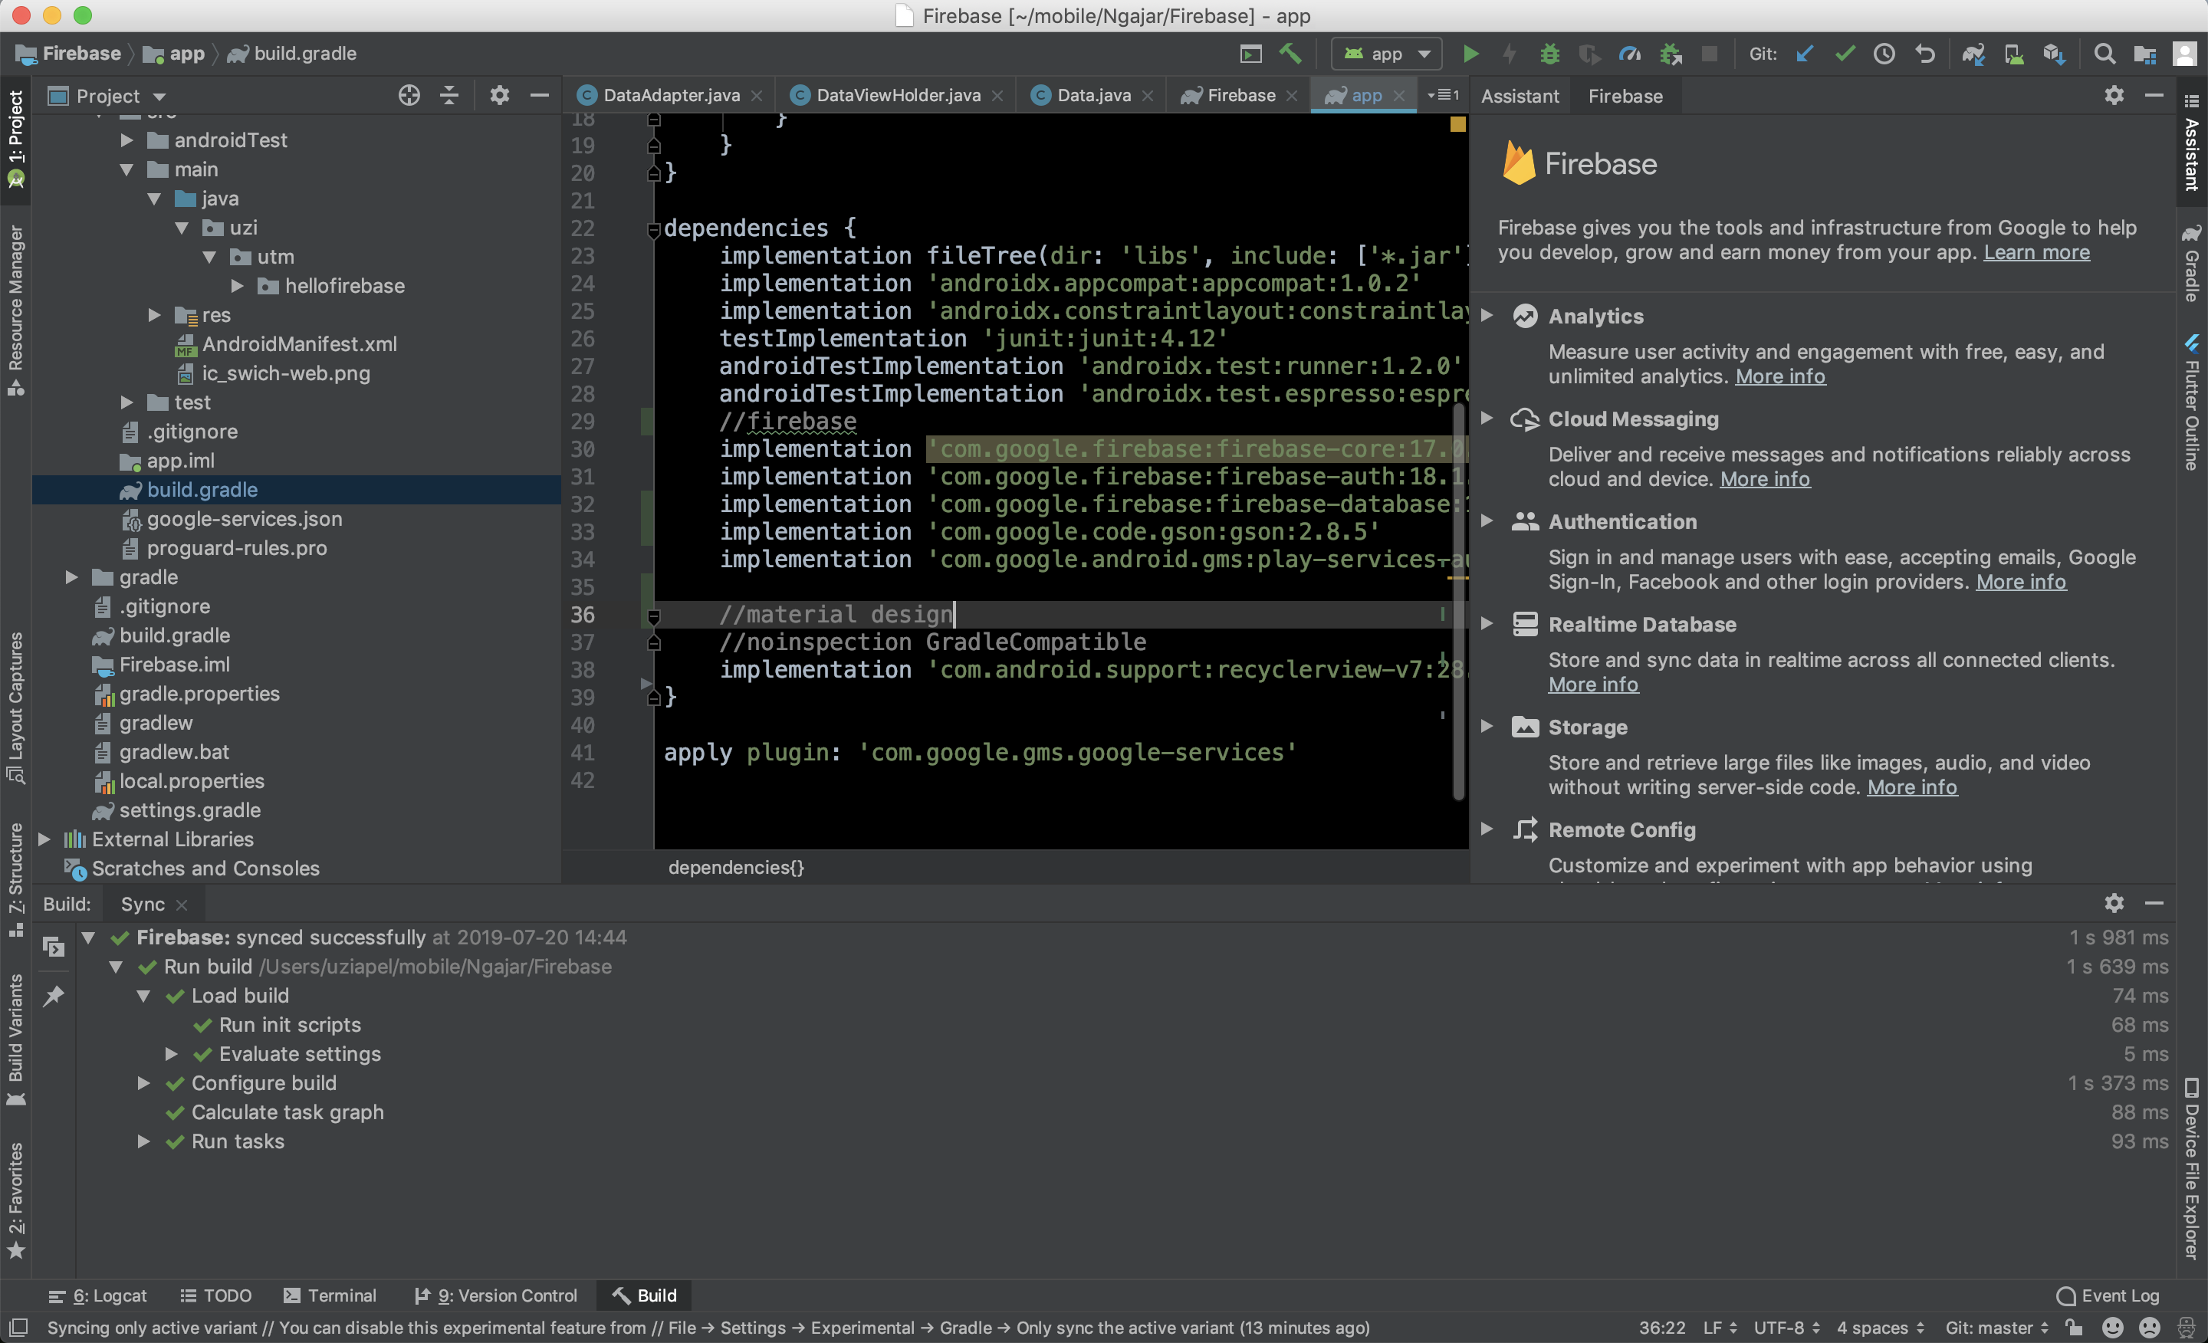
Add google-service.json

Slide 7
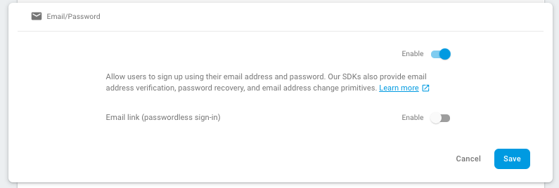
Auth Setup

Slide 8
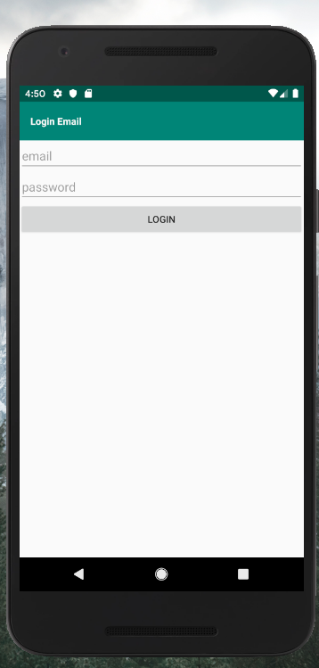
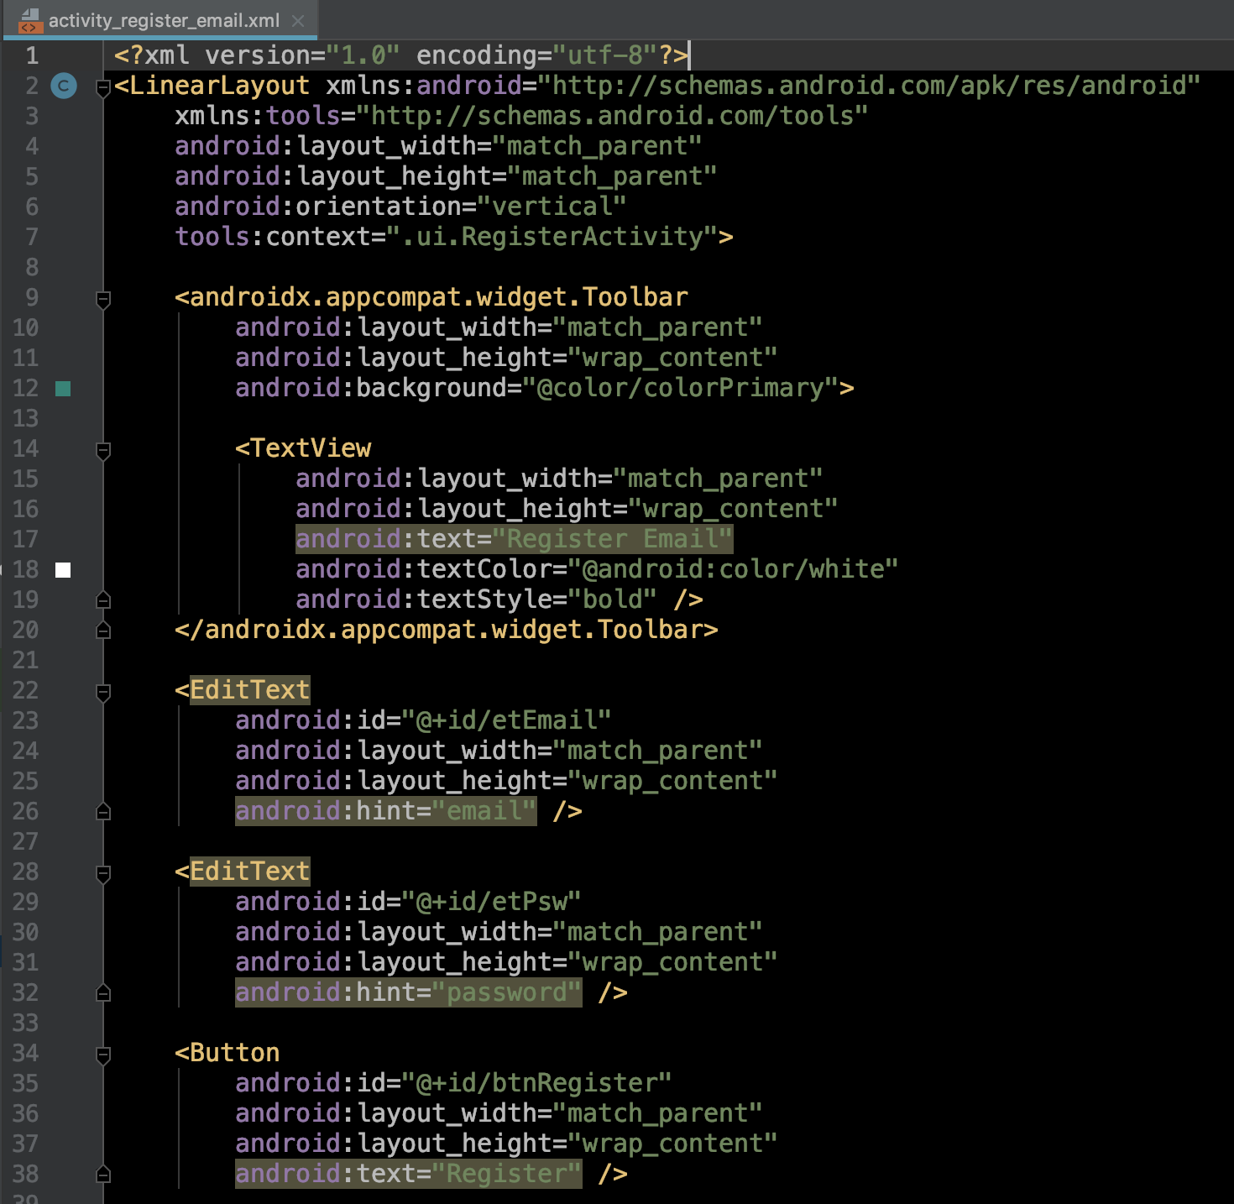
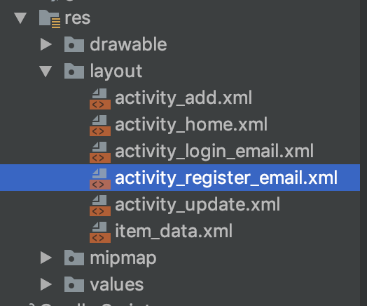
Register Setup
https://github.com/fauzisho/Android-Firebase-Module/blob/master/Firebase/app/src/main/res/layout/activity_register_email.xml

Slide 9
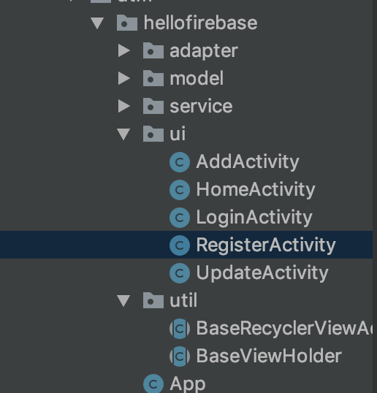
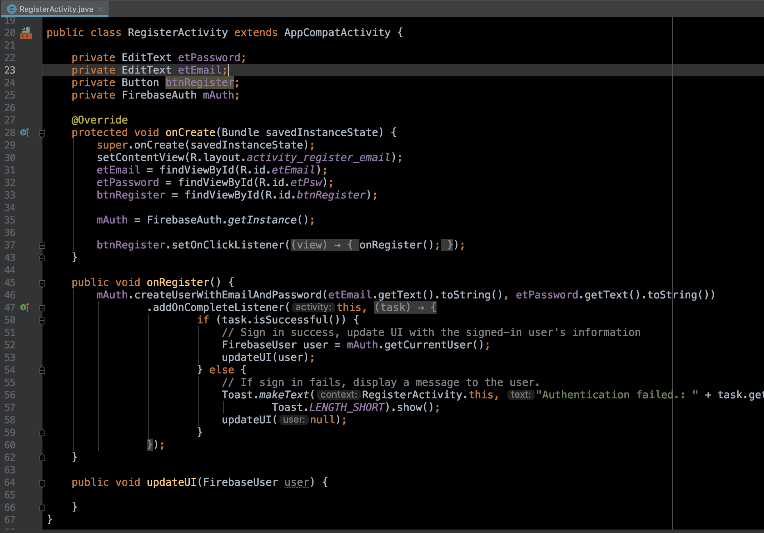
Register Setup
https://github.com/fauzisho/Android-Firebase-Module/blob/master/Firebase/app/src/main/java/uzi/utm/hellofirebase/UI/LoginActivity.java

Slide 10
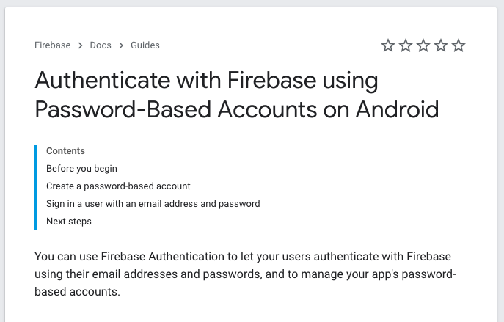
Push Register with Email & Password
https://firebase.google.com/docs/auth/android/password-auth

Slide 11
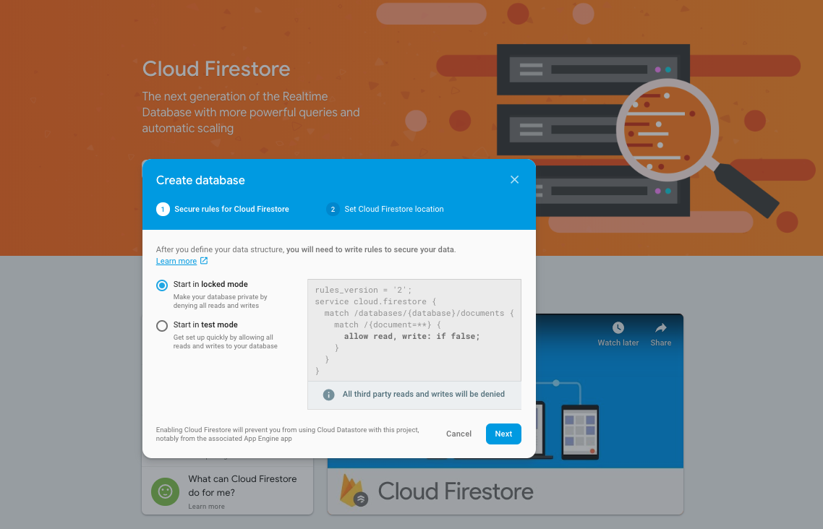
Realtime Database
https://firebase.google.com/docs/database/android/start

Slide 12
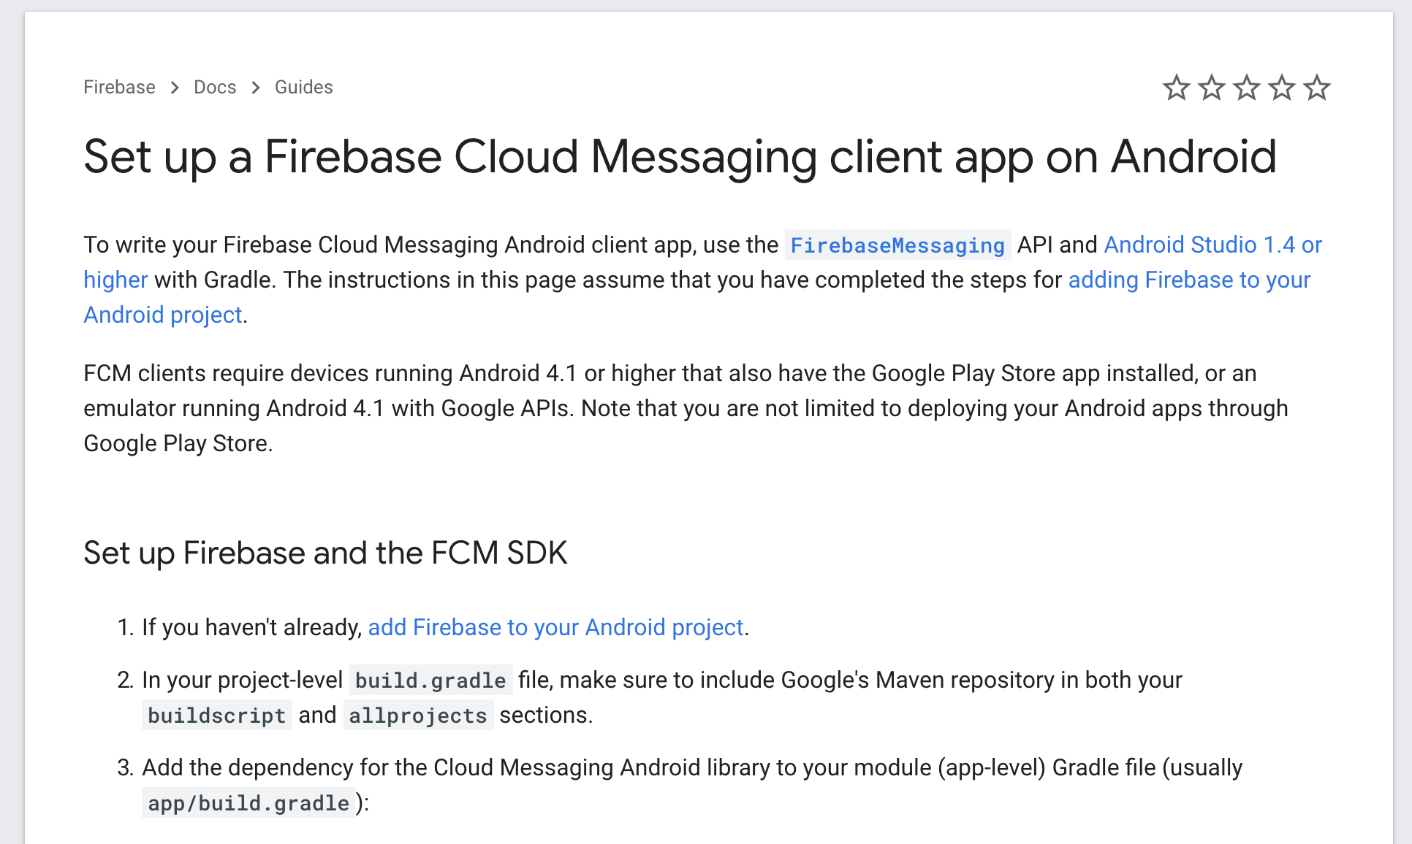
Firebase Cloud Messaging
https://firebase.google.com/docs/cloud-messaging/android/client

Slide 13
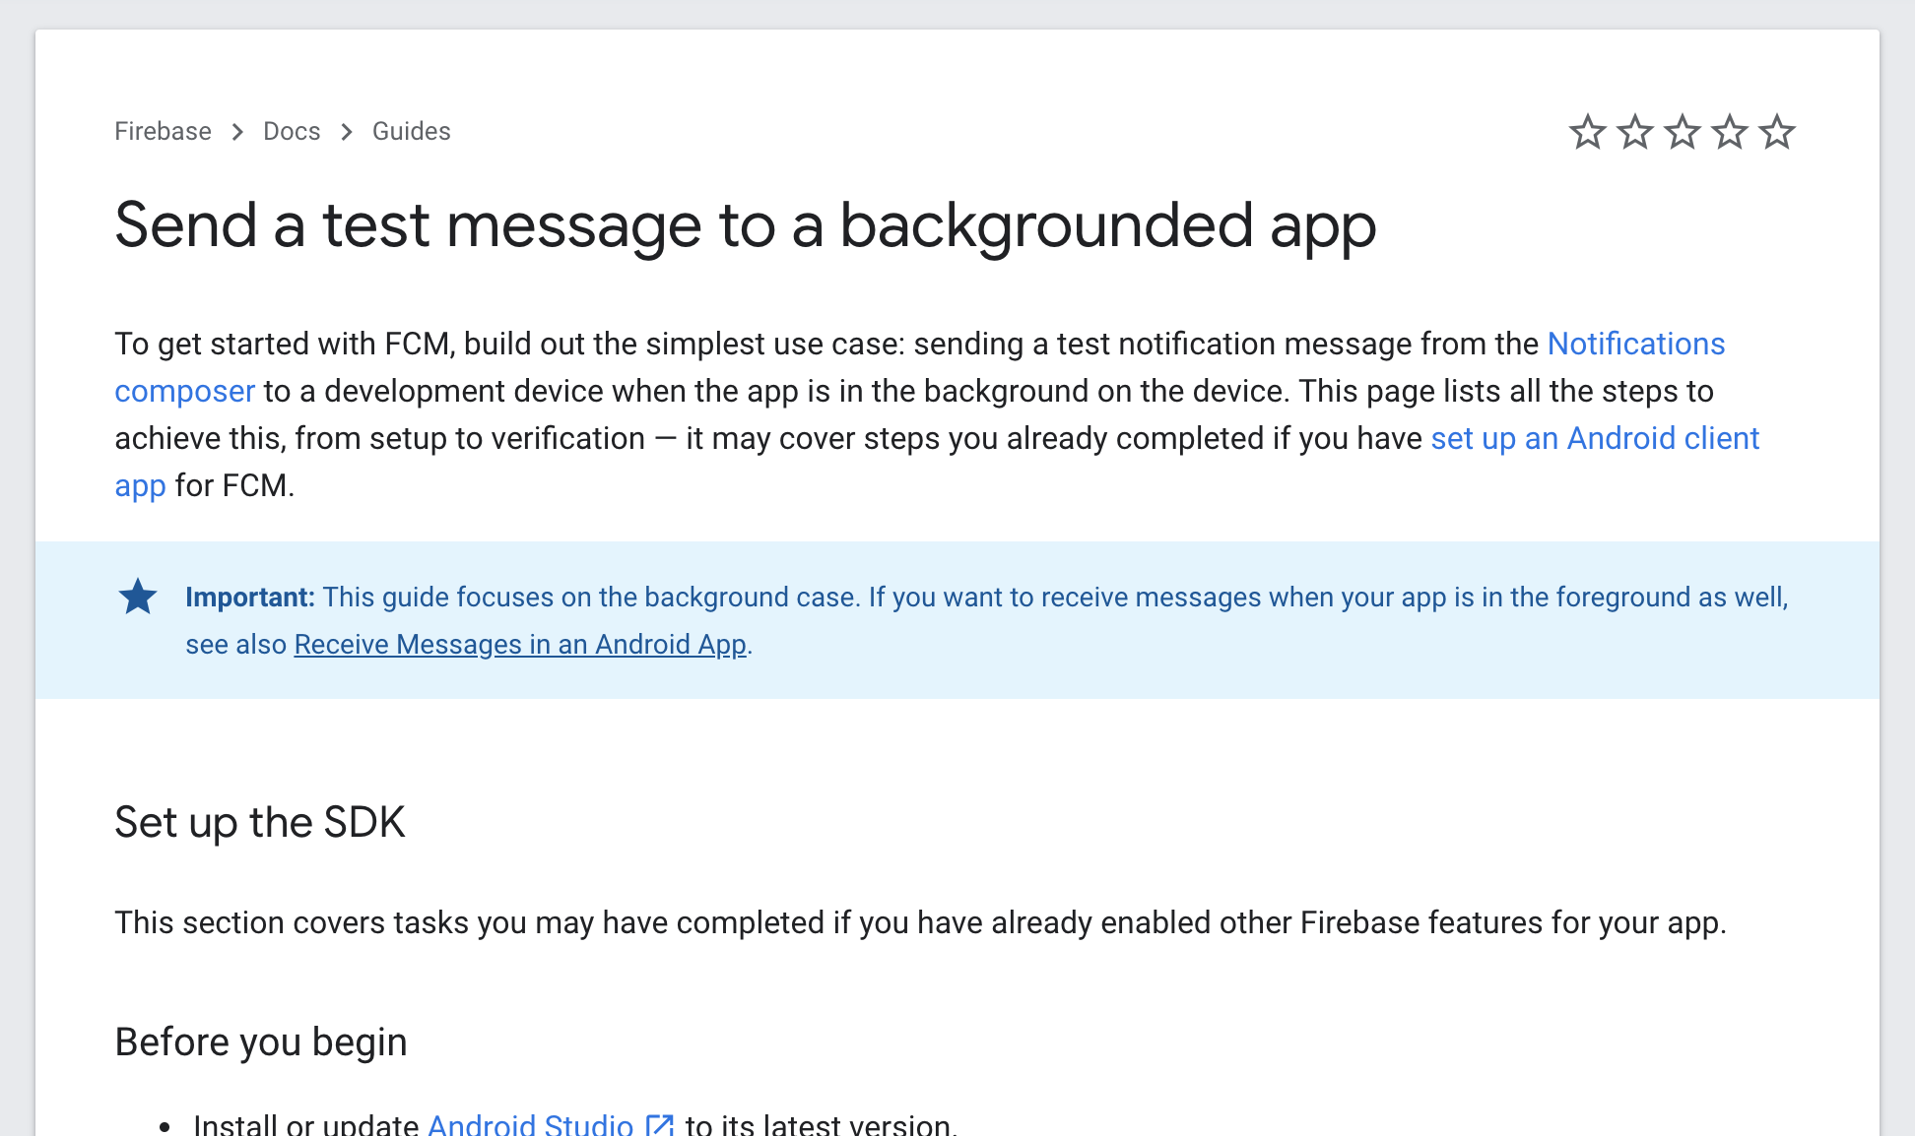
Firebase Cloud Messaging
https://firebase.google.com/docs/cloud-messaging/android/first-message

Slide 14
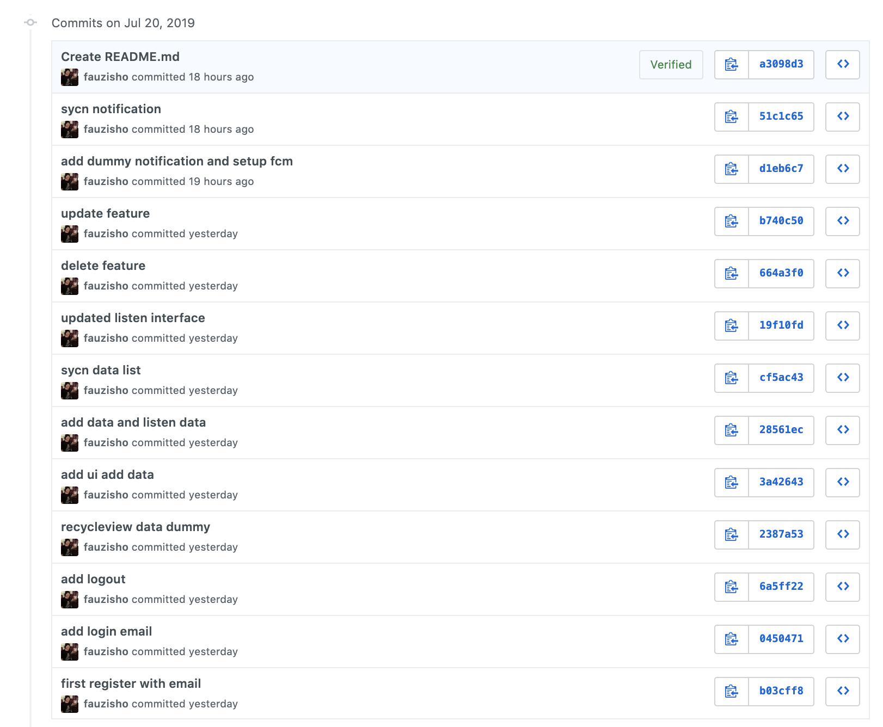
Coding Step by Step
https://github.com/fauzisho/Android-Firebase-Module/

